Slide 1

Practical Cryptography
Fall 2022
Practical Cryptography
Course work ONE – peer to peer Secure chat system
Supervisor: Ayman taha
course ID: KH6051
Name: Ahmed Farouk Mahmoud
Student ID: CU2000512

Slide 2
Application Choice
When starting this course work, I had the privilege to choose my own cryptographic application (A peer-to-peer chat system). There are several reasons why I choose to create a P2P chat system that uses cryptography.
Security
Privacy
Decentralization
Convenience
Notes:
With only 25 possible keys, the Caesar cipher is far from secure. A dramatic increase
in the key space can be achieved by allowing an arbitrary substitution. Before proceeding,
we define the term permutation . A permutation of a finite set of elements S
is an ordered sequence of all the elements of S, with each element appearing exactly
once.
For example, if S = {a, b, c}, there are six permutations of S :
abc, acb, bac, bca, cab, cba
In general, there are n ! permutations of a set of n elements, because the first
element can be chosen in one of n ways, the second in n - 1 ways, the third in n - 2
ways, and so on.
If, instead, the “cipher” line can be any permutation of the 26 alphabetic characters,
then there are 26! or greater than 4 * 10²⁶ possible keys. This is 10 orders of magnitude
greater than the key space for DES and would seem to eliminate brute-force
techniques for cryptanalysis. Such an approach is referred to as a monoalphabetic
substitution cipher, because a single cipher alphabet (mapping from plain alphabet
to cipher alphabet) is used per message.

Slide 3
Application Design Plan
1. Determine the scope and requirements of the P2P chat system
2. Design the user interface
3. Implement the P2P networking and communication layer
4. Implement the cryptographic layer
5. Test and debug the system
Notes:
With only 25 possible keys, the Caesar cipher is far from secure. A dramatic increase
in the key space can be achieved by allowing an arbitrary substitution. Before proceeding,
we define the term permutation . A permutation of a finite set of elements S
is an ordered sequence of all the elements of S, with each element appearing exactly
once.
For example, if S = {a, b, c}, there are six permutations of S :
abc, acb, bac, bca, cab, cba
In general, there are n ! permutations of a set of n elements, because the first
element can be chosen in one of n ways, the second in n - 1 ways, the third in n - 2
ways, and so on.
If, instead, the “cipher” line can be any permutation of the 26 alphabetic characters,
then there are 26! or greater than 4 * 10²⁶ possible keys. This is 10 orders of magnitude
greater than the key space for DES and would seem to eliminate brute-force
techniques for cryptanalysis. Such an approach is referred to as a monoalphabetic
substitution cipher, because a single cipher alphabet (mapping from plain alphabet
to cipher alphabet) is used per message.

Slide 4
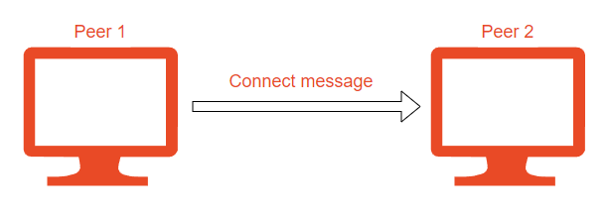
High-level overview of how my P2P Chat system works
1. Negotiating
No Authentication
10.10.10.2
10.10.10.1
Notes:
With only 25 possible keys, the Caesar cipher is far from secure. A dramatic increase
in the key space can be achieved by allowing an arbitrary substitution. Before proceeding,
we define the term permutation . A permutation of a finite set of elements S
is an ordered sequence of all the elements of S, with each element appearing exactly
once.
For example, if S = {a, b, c}, there are six permutations of S :
abc, acb, bac, bca, cab, cba
In general, there are n ! permutations of a set of n elements, because the first
element can be chosen in one of n ways, the second in n - 1 ways, the third in n - 2
ways, and so on.
If, instead, the “cipher” line can be any permutation of the 26 alphabetic characters,
then there are 26! or greater than 4 * 10²⁶ possible keys. This is 10 orders of magnitude
greater than the key space for DES and would seem to eliminate brute-force
techniques for cryptanalysis. Such an approach is referred to as a monoalphabetic
substitution cipher, because a single cipher alphabet (mapping from plain alphabet
to cipher alphabet) is used per message.

Slide 5
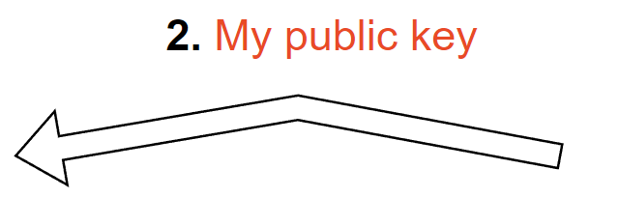
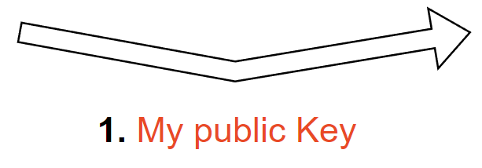
High-level overview of how my P2P Chat system works
2. Swapping Public Keys
No Authentication
10.10.10.2
10.10.10.1
Peer1: 2xxx
Peer1: 1xxx
Notes:
With only 25 possible keys, the Caesar cipher is far from secure. A dramatic increase
in the key space can be achieved by allowing an arbitrary substitution. Before proceeding,
we define the term permutation . A permutation of a finite set of elements S
is an ordered sequence of all the elements of S, with each element appearing exactly
once.
For example, if S = {a, b, c}, there are six permutations of S :
abc, acb, bac, bca, cab, cba
In general, there are n ! permutations of a set of n elements, because the first
element can be chosen in one of n ways, the second in n - 1 ways, the third in n - 2
ways, and so on.
If, instead, the “cipher” line can be any permutation of the 26 alphabetic characters,
then there are 26! or greater than 4 * 10²⁶ possible keys. This is 10 orders of magnitude
greater than the key space for DES and would seem to eliminate brute-force
techniques for cryptanalysis. Such an approach is referred to as a monoalphabetic
substitution cipher, because a single cipher alphabet (mapping from plain alphabet
to cipher alphabet) is used per message.

Slide 6
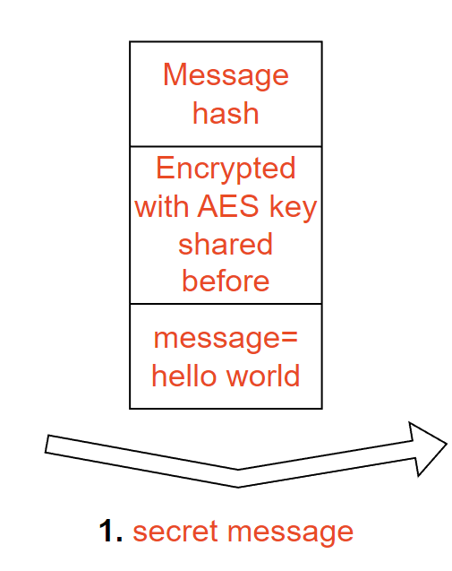
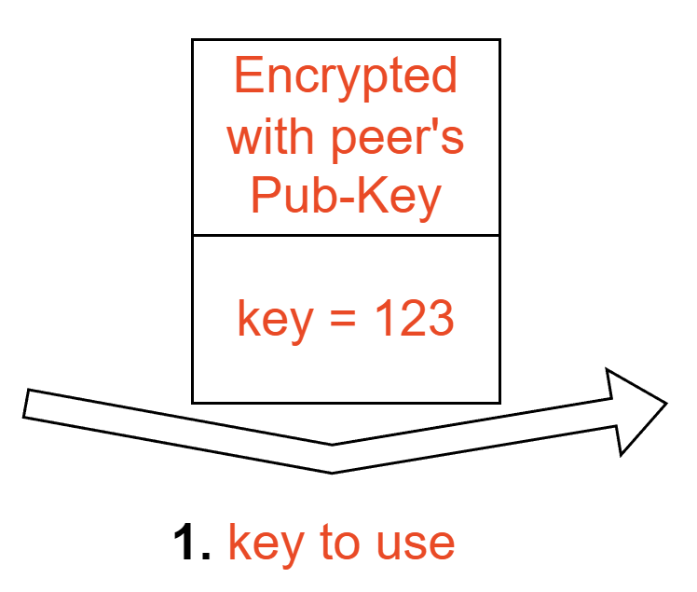
High-level overview of how my P2P Chat system works
3. AES key
4. Sending the messages
No Authentication
10.10.10.2
10.10.10.1
Peer1: 2xxx
Peer1: 1xxx
AES: 123
AES: 123
Notes:
With only 25 possible keys, the Caesar cipher is far from secure. A dramatic increase
in the key space can be achieved by allowing an arbitrary substitution. Before proceeding,
we define the term permutation . A permutation of a finite set of elements S
is an ordered sequence of all the elements of S, with each element appearing exactly
once.
For example, if S = {a, b, c}, there are six permutations of S :
abc, acb, bac, bca, cab, cba
In general, there are n ! permutations of a set of n elements, because the first
element can be chosen in one of n ways, the second in n - 1 ways, the third in n - 2
ways, and so on.
If, instead, the “cipher” line can be any permutation of the 26 alphabetic characters,
then there are 26! or greater than 4 * 10²⁶ possible keys. This is 10 orders of magnitude
greater than the key space for DES and would seem to eliminate brute-force
techniques for cryptanalysis. Such an approach is referred to as a monoalphabetic
substitution cipher, because a single cipher alphabet (mapping from plain alphabet
to cipher alphabet) is used per message.

Slide 7
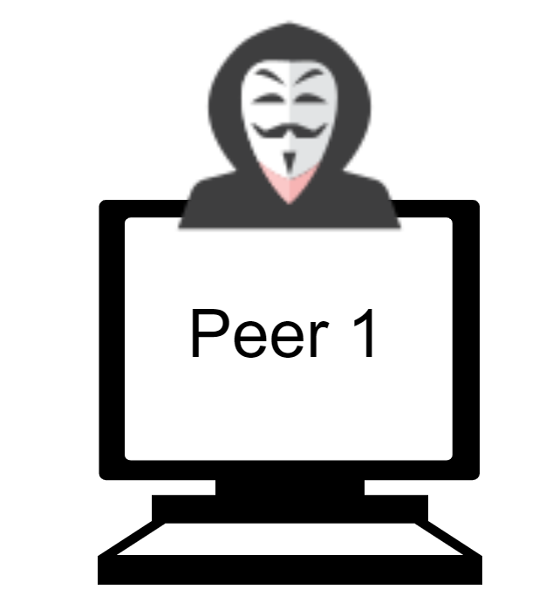
High-level overview of how my P2P Chat system works
1. Negotiating
No Authentication
10.10.10.1
Notes:
With only 25 possible keys, the Caesar cipher is far from secure. A dramatic increase
in the key space can be achieved by allowing an arbitrary substitution. Before proceeding,
we define the term permutation . A permutation of a finite set of elements S
is an ordered sequence of all the elements of S, with each element appearing exactly
once.
For example, if S = {a, b, c}, there are six permutations of S :
abc, acb, bac, bca, cab, cba
In general, there are n ! permutations of a set of n elements, because the first
element can be chosen in one of n ways, the second in n - 1 ways, the third in n - 2
ways, and so on.
If, instead, the “cipher” line can be any permutation of the 26 alphabetic characters,
then there are 26! or greater than 4 * 10²⁶ possible keys. This is 10 orders of magnitude
greater than the key space for DES and would seem to eliminate brute-force
techniques for cryptanalysis. Such an approach is referred to as a monoalphabetic
substitution cipher, because a single cipher alphabet (mapping from plain alphabet
to cipher alphabet) is used per message.

Slide 8
High-level overview of how my P2P Chat system works
2. Swapping Public Keys
No Authentication
10.10.10.2
10.10.10.1
Peer1: 2xxx
Peer1: 1xxx
Notes:
With only 25 possible keys, the Caesar cipher is far from secure. A dramatic increase
in the key space can be achieved by allowing an arbitrary substitution. Before proceeding,
we define the term permutation . A permutation of a finite set of elements S
is an ordered sequence of all the elements of S, with each element appearing exactly
once.
For example, if S = {a, b, c}, there are six permutations of S :
abc, acb, bac, bca, cab, cba
In general, there are n ! permutations of a set of n elements, because the first
element can be chosen in one of n ways, the second in n - 1 ways, the third in n - 2
ways, and so on.
If, instead, the “cipher” line can be any permutation of the 26 alphabetic characters,
then there are 26! or greater than 4 * 10²⁶ possible keys. This is 10 orders of magnitude
greater than the key space for DES and would seem to eliminate brute-force
techniques for cryptanalysis. Such an approach is referred to as a monoalphabetic
substitution cipher, because a single cipher alphabet (mapping from plain alphabet
to cipher alphabet) is used per message.

Slide 9
High-level overview of how my P2P Chat system works
3. AES key
4. Sending the messages
No Authentication
10.10.10.2
10.10.10.1
Peer1: 2xxx
Peer1: 1xxx
AES: 123
AES: 123
Notes:
With only 25 possible keys, the Caesar cipher is far from secure. A dramatic increase
in the key space can be achieved by allowing an arbitrary substitution. Before proceeding,
we define the term permutation . A permutation of a finite set of elements S
is an ordered sequence of all the elements of S, with each element appearing exactly
once.
For example, if S = {a, b, c}, there are six permutations of S :
abc, acb, bac, bca, cab, cba
In general, there are n ! permutations of a set of n elements, because the first
element can be chosen in one of n ways, the second in n - 1 ways, the third in n - 2
ways, and so on.
If, instead, the “cipher” line can be any permutation of the 26 alphabetic characters,
then there are 26! or greater than 4 * 10²⁶ possible keys. This is 10 orders of magnitude
greater than the key space for DES and would seem to eliminate brute-force
techniques for cryptanalysis. Such an approach is referred to as a monoalphabetic
substitution cipher, because a single cipher alphabet (mapping from plain alphabet
to cipher alphabet) is used per message.

Slide 10
High-level overview of how my P2P Chat system works
1. Negotiating
With Authentication
10.10.10.2
10.10.10.1
Notes:
With only 25 possible keys, the Caesar cipher is far from secure. A dramatic increase
in the key space can be achieved by allowing an arbitrary substitution. Before proceeding,
we define the term permutation . A permutation of a finite set of elements S
is an ordered sequence of all the elements of S, with each element appearing exactly
once.
For example, if S = {a, b, c}, there are six permutations of S :
abc, acb, bac, bca, cab, cba
In general, there are n ! permutations of a set of n elements, because the first
element can be chosen in one of n ways, the second in n - 1 ways, the third in n - 2
ways, and so on.
If, instead, the “cipher” line can be any permutation of the 26 alphabetic characters,
then there are 26! or greater than 4 * 10²⁶ possible keys. This is 10 orders of magnitude
greater than the key space for DES and would seem to eliminate brute-force
techniques for cryptanalysis. Such an approach is referred to as a monoalphabetic
substitution cipher, because a single cipher alphabet (mapping from plain alphabet
to cipher alphabet) is used per message.

Slide 11
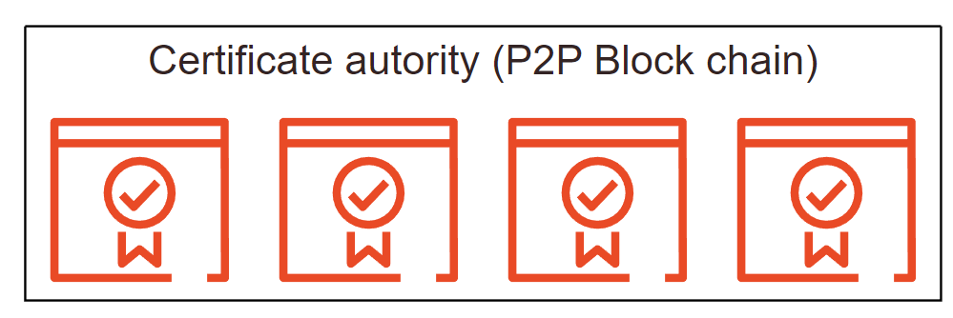
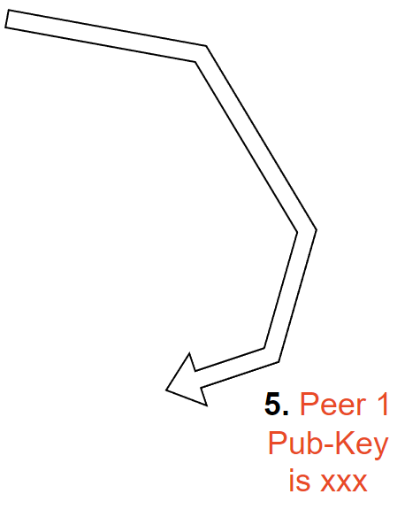
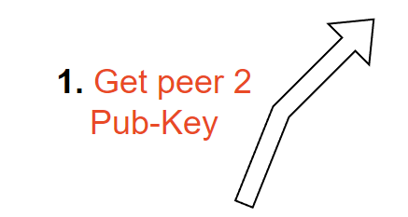
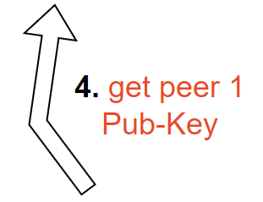
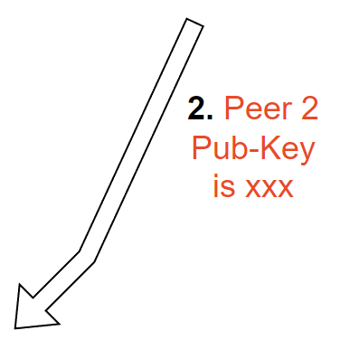
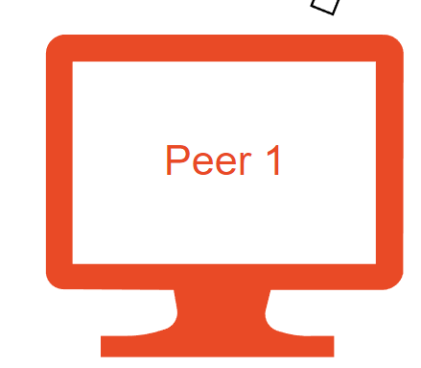
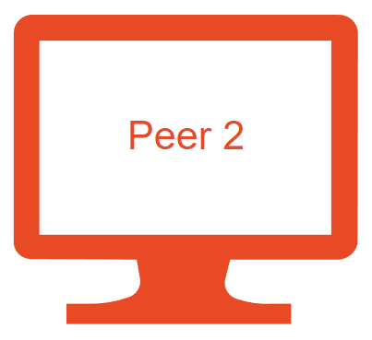
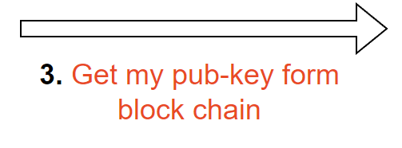
High-level overview of how my P2P Chat system works
2. Swapping Public Keys
With Authentication
Notes:
With only 25 possible keys, the Caesar cipher is far from secure. A dramatic increase
in the key space can be achieved by allowing an arbitrary substitution. Before proceeding,
we define the term permutation . A permutation of a finite set of elements S
is an ordered sequence of all the elements of S, with each element appearing exactly
once.
For example, if S = {a, b, c}, there are six permutations of S :
abc, acb, bac, bca, cab, cba
In general, there are n ! permutations of a set of n elements, because the first
element can be chosen in one of n ways, the second in n - 1 ways, the third in n - 2
ways, and so on.
If, instead, the “cipher” line can be any permutation of the 26 alphabetic characters,
then there are 26! or greater than 4 * 10²⁶ possible keys. This is 10 orders of magnitude
greater than the key space for DES and would seem to eliminate brute-force
techniques for cryptanalysis. Such an approach is referred to as a monoalphabetic
substitution cipher, because a single cipher alphabet (mapping from plain alphabet
to cipher alphabet) is used per message.

Slide 12
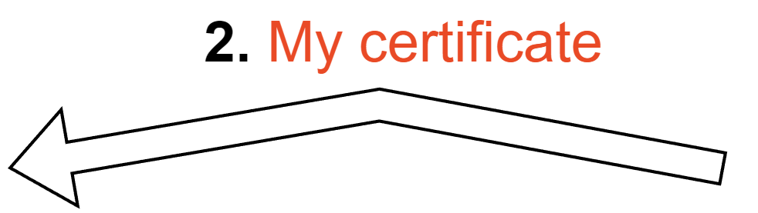
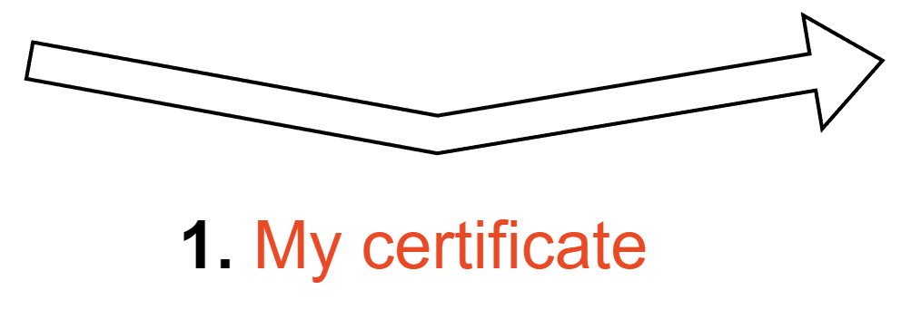
High-level overview of how my P2P Chat system works
3. Authentication
With Authentication
10.10.10.2
10.10.10.1
Peer1: 2xxx
Peer1: 1xxx
Notes:
With only 25 possible keys, the Caesar cipher is far from secure. A dramatic increase
in the key space can be achieved by allowing an arbitrary substitution. Before proceeding,
we define the term permutation . A permutation of a finite set of elements S
is an ordered sequence of all the elements of S, with each element appearing exactly
once.
For example, if S = {a, b, c}, there are six permutations of S :
abc, acb, bac, bca, cab, cba
In general, there are n ! permutations of a set of n elements, because the first
element can be chosen in one of n ways, the second in n - 1 ways, the third in n - 2
ways, and so on.
If, instead, the “cipher” line can be any permutation of the 26 alphabetic characters,
then there are 26! or greater than 4 * 10²⁶ possible keys. This is 10 orders of magnitude
greater than the key space for DES and would seem to eliminate brute-force
techniques for cryptanalysis. Such an approach is referred to as a monoalphabetic
substitution cipher, because a single cipher alphabet (mapping from plain alphabet
to cipher alphabet) is used per message.

Slide 13
High-level overview of how my P2P Chat system works
4. AES key
5. Sending the messages
No Authentication
10.10.10.2
10.10.10.1
Peer1: 2xxx
Peer1: 1xxx
AES: 123
AES: 123
Notes:
With only 25 possible keys, the Caesar cipher is far from secure. A dramatic increase
in the key space can be achieved by allowing an arbitrary substitution. Before proceeding,
we define the term permutation . A permutation of a finite set of elements S
is an ordered sequence of all the elements of S, with each element appearing exactly
once.
For example, if S = {a, b, c}, there are six permutations of S :
abc, acb, bac, bca, cab, cba
In general, there are n ! permutations of a set of n elements, because the first
element can be chosen in one of n ways, the second in n - 1 ways, the third in n - 2
ways, and so on.
If, instead, the “cipher” line can be any permutation of the 26 alphabetic characters,
then there are 26! or greater than 4 * 10²⁶ possible keys. This is 10 orders of magnitude
greater than the key space for DES and would seem to eliminate brute-force
techniques for cryptanalysis. Such an approach is referred to as a monoalphabetic
substitution cipher, because a single cipher alphabet (mapping from plain alphabet
to cipher alphabet) is used per message.

Slide 14
Cryptographic Algorithms Used
Cryptographic algorithms are mathematical techniques used to secure communication and protect data from unauthorized access or tampering. There are many different cryptographic algorithms that I used for different purposes in the application, including:
Asymmetric-key algorithms
In my peer-to-peer application I used RSA for 2 main purposes. Sharing a secret symmetric key and authentication. To share a secret symmetric key peer1 generates a key and encrypts it with the peer2’s public key so only the peer2 can decrypt the key using his private key. As for authentication, peer one sends peer 2 a message encrypted by peer1’s private key allowing peer2 to decrypt it and authenticate peer 1.
Symmetric-key algorithms
In my peer-to-peer application I used AES as the main encryption algorithm for encrypting the messages sent between peers. I used a 128-bit key that is randomly generated by one o the peers and sent to the other peer to use. Although is very secure, it can be vulnerable to brakeforce attacks after having about 32 GB of data encrypted with the same key. To fix this, I implemented Key rotation that means I change the key after about 5 to 10 messages.
Decentralization
In my peer-to-peer application I used hashes to verify the integrity of the messages being sent. Peer 1 hashes the message sent to peer 2 and peer 2 compares the hash before decrypting the message. If the message was tampered with or changed the hash would not match and the connection will drop.
Notes:
With only 25 possible keys, the Caesar cipher is far from secure. A dramatic increase
in the key space can be achieved by allowing an arbitrary substitution. Before proceeding,
we define the term permutation . A permutation of a finite set of elements S
is an ordered sequence of all the elements of S, with each element appearing exactly
once.
For example, if S = {a, b, c}, there are six permutations of S :
abc, acb, bac, bca, cab, cba
In general, there are n ! permutations of a set of n elements, because the first
element can be chosen in one of n ways, the second in n - 1 ways, the third in n - 2
ways, and so on.
If, instead, the “cipher” line can be any permutation of the 26 alphabetic characters,
then there are 26! or greater than 4 * 10²⁶ possible keys. This is 10 orders of magnitude
greater than the key space for DES and would seem to eliminate brute-force
techniques for cryptanalysis. Such an approach is referred to as a monoalphabetic
substitution cipher, because a single cipher alphabet (mapping from plain alphabet
to cipher alphabet) is used per message.

Slide 15
Security Concerns
Confidentiality
Integrity
Authentication
It is important to ensure that the messages being exchanged between peers are kept confidential and are not accessible to unauthorized parties. This can be achieved using encryption as I used RSA public keys to exchange a 128-bit AES key. And every 5 to 10 messages sent the 2 peers change the AES key used, this is known as key rotation, and it is Implemented to ensure that brute force attacks are not possible.
It is important to ensure that the messages being exchanged between peers have not been tampered with or modified during transmission. This can be achieved using hashes, as every peer hashes every message before sending it and the other peer verifies the hash.
It is important to verify the identity of the peers participating in the chat to prevent impersonation attacks. This is achieved using a P2P block chain certificate authority that verifies peers’ public keys and their respective IPs.
Notes:
With only 25 possible keys, the Caesar cipher is far from secure. A dramatic increase
in the key space can be achieved by allowing an arbitrary substitution. Before proceeding,
we define the term permutation . A permutation of a finite set of elements S
is an ordered sequence of all the elements of S, with each element appearing exactly
once.
For example, if S = {a, b, c}, there are six permutations of S :
abc, acb, bac, bca, cab, cba
In general, there are n ! permutations of a set of n elements, because the first
element can be chosen in one of n ways, the second in n - 1 ways, the third in n - 2
ways, and so on.
If, instead, the “cipher” line can be any permutation of the 26 alphabetic characters,
then there are 26! or greater than 4 * 10²⁶ possible keys. This is 10 orders of magnitude
greater than the key space for DES and would seem to eliminate brute-force
techniques for cryptanalysis. Such an approach is referred to as a monoalphabetic
substitution cipher, because a single cipher alphabet (mapping from plain alphabet
to cipher alphabet) is used per message.

Slide 16
Security Concerns
Testing the strength of the keys being used for encryption. After attempting to brute force, the AES or the RSA key it was not possible in a human’s lifetime making it almost impossible to brute force the keys.
Testing the system's ability to resist man-in-the-middle attacks. this was done by attempting to intercept and modify messages as they are being transmitted between peers. But failed as all the messages where encrypted and tampering with the encrypted message changes it’s hash.
Testing the system's ability to resist replay attacks, where an attacker captures and re-sends a valid message to trick the system into performing an undesired action. In my application this was the only flow I had and to fix this I need to add a random number that both peers agree on and then every message sent must be greater than that random number by a fixed value, so I an attacker was to send the same message twice it would not be equal to the needed number resulting in the application dropping the connection.
Notes:
With only 25 possible keys, the Caesar cipher is far from secure. A dramatic increase
in the key space can be achieved by allowing an arbitrary substitution. Before proceeding,
we define the term permutation . A permutation of a finite set of elements S
is an ordered sequence of all the elements of S, with each element appearing exactly
once.
For example, if S = {a, b, c}, there are six permutations of S :
abc, acb, bac, bca, cab, cba
In general, there are n ! permutations of a set of n elements, because the first
element can be chosen in one of n ways, the second in n - 1 ways, the third in n - 2
ways, and so on.
If, instead, the “cipher” line can be any permutation of the 26 alphabetic characters,
then there are 26! or greater than 4 * 10²⁶ possible keys. This is 10 orders of magnitude
greater than the key space for DES and would seem to eliminate brute-force
techniques for cryptanalysis. Such an approach is referred to as a monoalphabetic
substitution cipher, because a single cipher alphabet (mapping from plain alphabet
to cipher alphabet) is used per message.

